Slide 1
TF II Draft template to report at TF meeting
GPFM: Task Force II Europe members’ update
yyy date
yyy name
Task Force II member

Slide 2
FP1 Task Force II Europe (1/4)
TF II Draft template to report at TF meeting
Lead: Country
TF II Members: Austria, EC, Germany, UK, Alperia (IT), Areti (IT), Enel Grids (IT), Icebreaker One (UK), National Grid (UK), BSI (UK), ENA (UK), GSE (IT), Terna (IT)
Main outcomes for the period and next steps –
Q4/’23 (Oct. – Dec.), Q1/’24 (Jan. - Mar.)
Q2/’24 (Apr. - June), Q3/’24 (July – Sept.)
Main outcomes with respect to the info reported in the National Pilot Projects Report of July 2023
……
……
……
……
……
Project highlights:
Contact person/ organization: ……………………… ……………………………………………………………………………………………
Title/acronym: …………………………………………………………. …………………………………………………………………………………………….
Phase: ……………………………………………………………………………. (launch, study and simulation, implementation, etc.)
Budget: ……………………………………………………. xyxy M€ (0-5 M€, 5-10 M€, …)

Slide 3
FP1 Task Force II Europe (2/4)
TF II Draft template to report at TF meeting
Main outcomes for the period and next steps –
Q4/’23 (Oct. – Dec.), Q1/’24 (Jan. - Mar.), Q2/’24 (Apr. - June), Q3/’24 (July – Sept.)
Achievements ready to be uploaded in the GPFM toolbox
Please insert title and short summary for each achievement (up to 500 characters)

Slide 4
FP1 Task Force II Europe (3/4)
TF II Draft template to report at TF meeting
Main outcomes for the period and next steps –
Q4/’23 (Oct. – Dec.), Q1/’24 (Jan. - Mar.), Q2/’24 (Apr. - June), Q3/’24 (July – Sept.)
Next actions and foreseen activities

Slide 5
FP1 Task Force II Europe (4/4)
TF II Draft template to report at TF meeting
Main outcomes for the period and next steps –
Q4/’23 (Oct. – Dec.), Q1/’24 (Jan. - Mar.), Q2/’24 (Apr. - June), Q3/’24 (July – Sept.)
Main synergies with other R&I projects
By co-Leads with members’ support

Slide 6
FP1 Task Force II Europe: notes
TF II Draft template to report at TF meeting
Please feel free to add here any notes you believe are relevant about your project

Slide 7
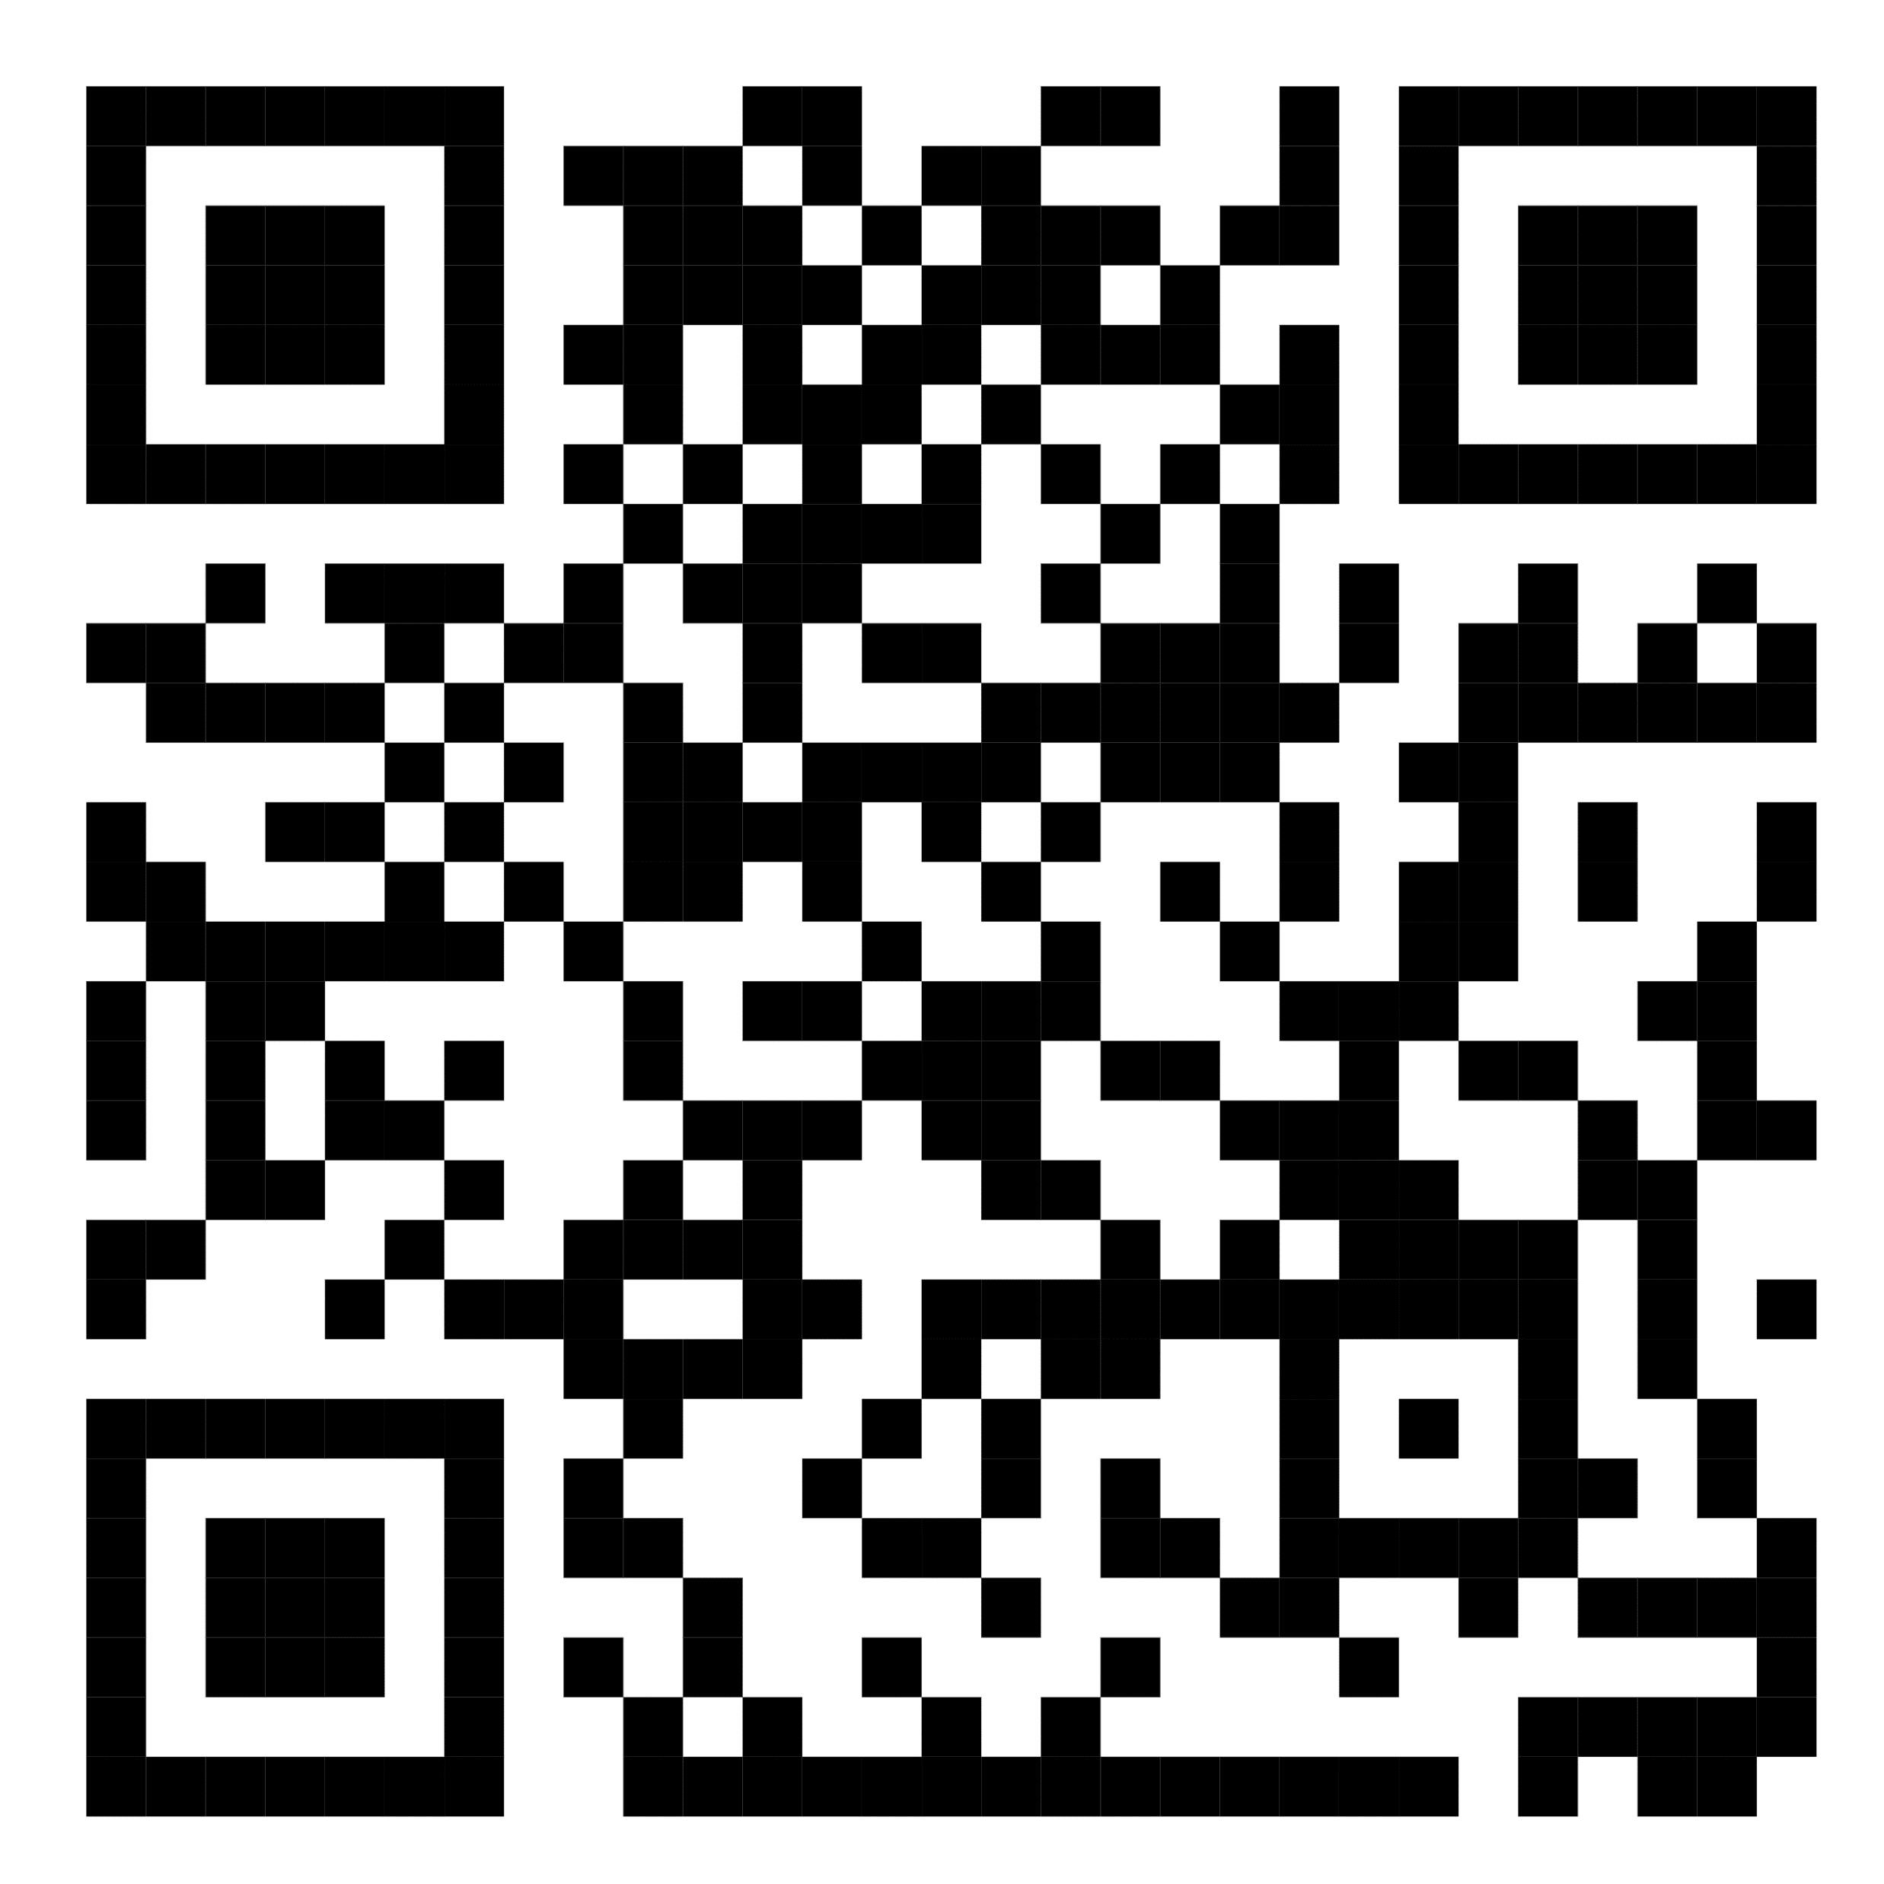
TF II Draft template to report at TF meeting
Thank you for your attention
Main Contacts for Task Force II Europe:
Oscar Izquierdo Monge Spain lead oscar.izquierdo@ciemat.es
Felix Téllez Spain lead felix.tellez@ciemat.es
Luis Manuel Santos Spain lead lsantos@edp.com
Luciano Martini luciano.martini@rse-web.it
Mattia Cabiati Italy lead mattia.cabiati@rse-web.it
Follow us on:
Mission Innovation site
LinkedIn

